Slide 1
EUFAR2
Stratospheric Airborne Science workshop
Rome 4-5 May 2017

Slide 2
Rationale and Outcomes
The EUFAR Questionnaire
The research topic
The availability of platforms
Recommendations on how to continue stratospheric airborne research in the coming decade

Slide 3
Goals of the Questionnaire
  To evaluate the capability of the existing fleet in response to the scientific needs.
  To provide directions for enhancing the capability of the fleet.
  To outline strategies for the long-term development of the fleet.
  To define forthcoming challenges in airborne research.

Slide 4
Feedbacks and results
  Questionnaire on-line from 20 November 2014 to 20 January 2015
  Invitation sent to everyone in the EUFAR mailing lists, and relevant European geoscience research Institutions
  More than 150 responders
  Reccommendations: Focus on smaller number of high capability aircraft; common data standards; need for a common scientific European aircraft

Slide 5
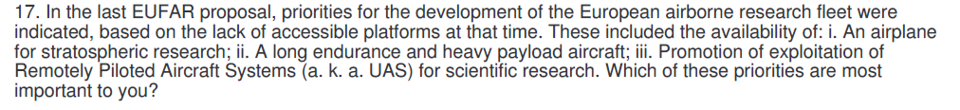
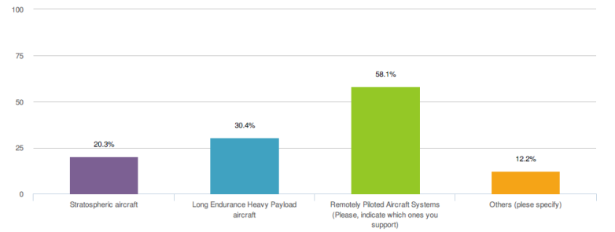
Questionnaire Report
The questionnaire and the results can be accessed here: http://eufar.net/cms/user-needs-survey/

Slide 6
Transport
Measure the Distribution of long lived species, controlled by wave-driven circulation and quasi-horizontal mixing, which is weaker in mixing barrier regions. (both processes are linked to wave activity, thus varying with height and season.) Processes to be studied are tropical ascent, mixing between tropics and extratropics, descent and isolation of the polar vortex.
Measure the Tropical Ascent Rate: Most air enters stratosphere in the tropics: it is thus a critical region. Air there slowly ascent with limited horizontal mixing (evidence is the vertically propagating signal of CPT temperature in WV mixing ratio: the “tape recorder”). “Mean age” is the time elapsed since a stratospheric air parcel has been last in contact with the troposphere. It is computed from conserved tracers with known tropospheric trends (CO2, SF6). Measurements are needed to quantitatively evaluate model representations of the circulation and mixing. Age gradients depends only on tropical ascent rate. The difference in mean age between tropics and midlatitudes can assess tropical ascent.
Assess Mixing and STE in the tropics, to influence the stratosphere as a whole, and in the extratropic connected to tropopause folds and frontal activity: Tape recorder amplitude decaying with height because of vertical diffusion and dilution with midlatitudes, which account for most of the attenuation. Tropical mean age reflects the combination of large scale ascent, vertical diffusion and horizontal mixing across the subtropics. In tropical lower stratosphere, is a local diagnostic of the circulation and mixing. Key measurements are the definition of the sharpness of latitudinal gradient of long lived species ( Methane, Nitrous oxide, CFCs), their Probability Density Functions (PDF), and their correlations. Exchanges between tropics and midlatitudes may be assessed by inspecting the perturbation to the upward propagation of the seasonal cycles in CO2 and H2O.

Slide 7
Composition
Study the Fractional release of Cly from (CFC12 and 11) measures how much of the source gas is photolized or oxidized since the entry in stratosphere
Obtain vertical profiles and tracer-tracer correlations of radical presursors (N2O, O3, Noy, CLy, BRy) and their seasonal evolution; Comparison with climatologies.
Monitoring precursors and radicals and their variability connected both with photochemical processes and heterogeneous chemistry on cloud and aerosol. (istance: poorly know photochemical degradation of VSLS and VOC or their heterogeneous reactions on cirrus or SSA particles – clorine activation; uptake of HNO3 and HCl, Hox budget and chemistry still not well represented)

Slide 8
Radiation
Interest to determine the actinic fluxes and how they vary with respect to the underlying surfaces (ground, high level clouds) to properly constrain the stratospheric photochemistry
Measurements of the surface albedo of the Earth with its two-dimensional scattering properties
Measurements of aerosols and clouds with their contribution to both the greenhouse effect and the albedo at the top of the atmosphere, as operating at an altitude close to the boundary conditions of radiative processes
deploy new ERB instruments without the long development time and high cost of new space-borne instruments
acquire measurements coincident with those of the existing satellite ERB measuring instruments

Slide 9
Ecosystems and Climate
ecosystem photosynthetic rate monitoring and its relationship with climate change;
soil behaviour and soil behaviour modification monitoring;
monitoring of ecosystems carbon storage. The validation of satellite hyperspectral measurements with high resolution measurements that are not feasible from space.
Flight demonstration of photosynthesis efficiency measurements made with new techniques (either Laser Induced Fluorescence or Fraunhofer Line discrimination principle)

Slide 10
Water Cycle
Precipitation is the key physical process that links weather, hydrological cycle and climate.
Assess the ability of different types of particles to act as CCN and IN as a function of their size, origin and air mass history
Assess the influence of anthropogenic aerosol on cloud microstructure in different areas
To study the nature and development of hazardous storms
To quantify the role of snowfall in the water cycle at high latitudes

Slide 11
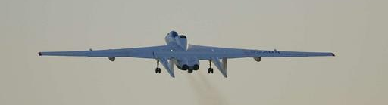
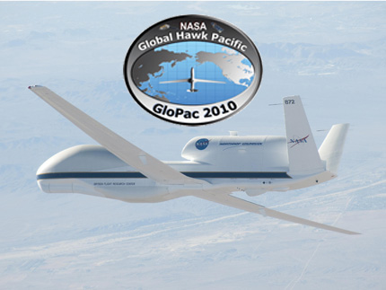
Ways ahead…
Maintaining the capability for stratospheric airborne research
M55-Geophysica
The one and only European stratospheric aircraft
Accessing new, existing and foreseen platforms
Notes:
Ways ahead: keeping the present observational capabilitis and encouraging transnational access to novel platforms, as the UAS GH, that would allow to follow the diurnal variation of chemical species and clouds, can rapidly deploy new instruments with space-time coverage comparable to space-borne ones, thus becoming complementary and competitive with satellites. Allow deployment in otherwise unaccessible regions (where the deepest convection occurs – central africa, or in remote sites in Antarctica).

