Slide 1
Towards the constitution of the EUFAR AISBL
Supporting documents for general discussion
É. Gérard, Météo-France, bureau@eufar.net

Slide 2
Agenda

Slide 3
Time | Meeting agenda (modifications wrt draft agenda in orange)
10:00 | Introduction & agenda É. Gérard
10:05 | Status of actions listed during Meeting 10 Report on progress and outstanding issues: - Progress towards acknowledgement-in-principle of the potential Members - H2020 Work Programme 2018-2020 - Report on KWM findings & recommendations - IPR ownership issue raised during Meeting 10 - Amendment & validation of the Statutes & Internal Regulations (Final version) - Financial Plan: Membership fees É. Gérard as a support to discussion All
13:00 | Lunch break
14:00 | Continuation of the discussion - Seat allocation (EB members incl. Treasurer, and GA President and Vice-President) - Designation of the rep (proxy) who will act for all Members when setting up the AISBL (granting authority to the notary, etc.) - Choice of a bank (can be postponed) - Deposit of the Statutes: documents requested & planning - H2020 proposal: how to draft a successful proposal? All
16:45 | AOB Actions and conclusion É. Gérard
17:00 | End of meeting (audio connection cut)
H2020 & technical issues
Towards deposit & proposal

Slide 4
Status of actions listed during Meeting 10

Slide 5
Status of actions listed during Meeting 10

Slide 6
Report on progress and outstanding issues

Slide 7
AISBL working group composition
DLR
Valeska Rauchfuß replaced by Alexandra Caspers
CNRS
Marie Lamothe left and was not replaced
ONERA
Grégoire Molas (Legal Directorate) joined
Thanks to Valeska & Marie !
Welcome (back) to Alexandra & Grégoire !

Slide 8
Progress towards acknowledgement-in-principle
Country | Members | Progress towards acknowledgement-in-principle
Belgium | VITO | Approval by VITO Managing Director 16 May 2017
Czech Republic | CzechGlobe
France | CNRS | Approval by Legal Department and Finance Department May 2017
 | Météo-France | Unanimous approval of the Board of Directors 13 March 2017
 | ONERA
Germany | DLR | Approval of the Board of Directors not before 22 May; internal document prepared for the meeting
 | FUB
Israel | TAU
Italy | CNR | Meeting with the new Director of Department by the end of May; authorisation procedure takes about 3 to 4 months from the reception by the Board of Directors of the approval of the Director of the Department
Poland | UWAR | Statutes approved by the jurists; should join as a founding Member before constituting a national consortium
Spain | INTA
UK | Met Office | Approval of the relevant Met Office Executives might be obtained by 18 May; internal document submitted, response awaited; the person most immediately relevant who needs to agree has done so, but comment back from Chief Scientist awaited

Slide 9
H2020 Multi Annual Plan (MAP) for Integrating Activities – Advanced Communities Working Document (28/03/2017)
Call H2020-INFRAIA-2018-2020, Topic INFRAIA-01-2018-2019, Deadline 2018, Publication Nov 2017
Budget of ~110 M€ for all S&T fields
Total of 22 invited areas, about 11 projects to be funded (50% success rate)
Expected start date of grant agreements end 2018 – beginning 2019
Research aircrafts for environmental and geo-science research. This activity aims at integrating key research aircrafts and improving their availability to European researchers from larger multidisciplinary scientific communities. It should develop a long-term strategy towards sustained integrated services and innovative synergies with complementary observing systems and models to study atmospheric processes.
Justification:
Previous grant (EUFAR2) ending on 31/1/2018
This topic is of high relevance to mitigation strategies related to climate change
Supports research within SC5 (H2020 Societal challenge Climate action, environment, resource efficiency and raw materials)

Slide 10
Issues to be addressed within INFRAIA
EUFAR partners invited in late April to contact their NCP’s
to broaden the scope of activities: “to study atmospheric processes and the Earth surface”.
to counter some countries (Portugal) who try to remove this topic, on the ground that the creation of the AISBL means that support to EUFAR will now be directly from Member States (which is wrong !)
Risk of being excluded from INFRAIA and moved to INFRADEV (individual support to ESFRI and OWCRI) because of the creation of the AISBL (to avoid duplication)
No feedback on the MAP final decision (meeting on 12 May)

Slide 11
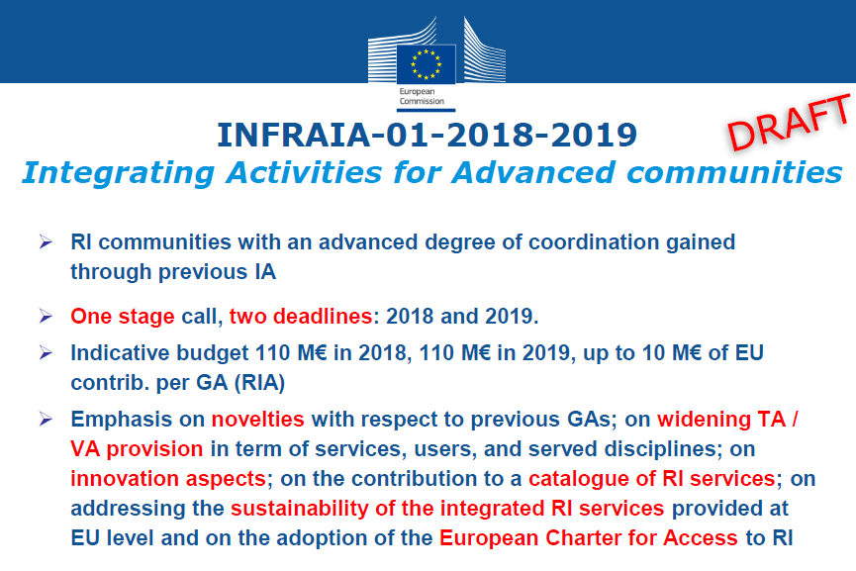
INFRAIA opportunity

Slide 12
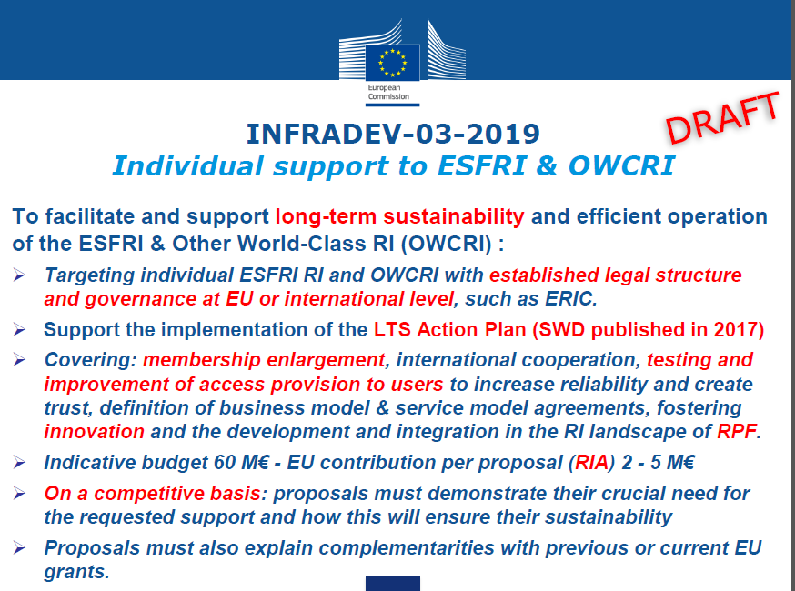
INFRADEV opportunity

Slide 13
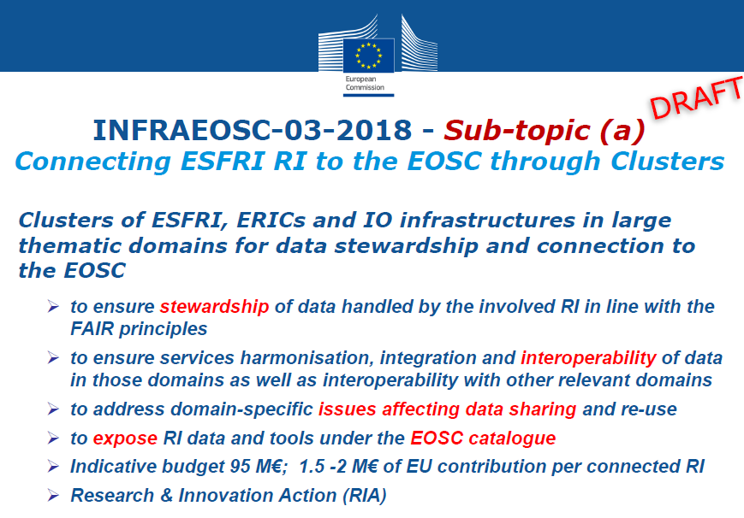
INFRAEOSC opportunity

Slide 14
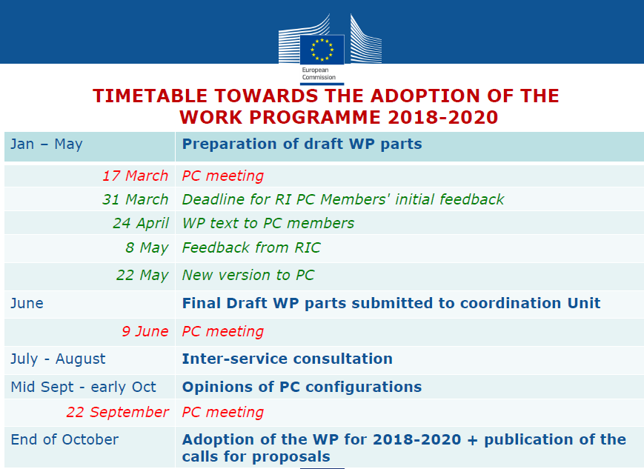
Timetable towards adoption of WP 2018-2010

Slide 15
Report on KWM findings & recommendations Legal expertise
Verification of the Statutes with the Belgian law, in particular investigation on the transfer of articles from the Internal Regulations to the Statutes, should those be compulsory
Minor changes & no transfer
New section in the Statutes: TRANSITIONAL PROVISIONS-APPOINTMENT
Verification of the possibility of excluding, in the event of an audit, the expenses within the perimeter of another audit, i.e. certificate on the financial statement (CFS) of the EC
Art 15.2(9) & 24.2 of the Statutes and Art. 14.7 of the Internal Regulations slightly changed
Translation of the Statutes and Internal Regulations in French
Corrections required
Ongoing action with the help of Élodie Couvet (CNRS)
Clarification of the possibilities and modalities of acting in the name of the AISBL before the deed of incorporation
Addition of Art 29.3 in the Statutes
Deposit of the Statutes
Not yet…

Slide 16
Report on KWM findings & recommendations Tax expertise
Clarification of the perimeter of exemption/non-exemption of VAT
VAT (21%) exemption subject to the strict satisfaction of 4 conditions
Not-for-profit association
Deliverance of services in the collective interest of the Members
Aim within a list of specific objectives
Activities financed by the membership fees
Membership fees are exempt from VAT (philanthropic object pursued)
Commercial activities and activities with non-Member third parties are subject to VAT
Mixed VAT taxpayer
Agreement with the Belgian tax administration to be sought
Estimation of the taxes relating to the AISBL
Subject to a tax regime called “tax on legal entities” (impôt des personnes morales)
Taxation rate on dividends and interests is 30%
If side business is carried out,
subject to the tax on legal entities regime only if the business is
(i) secondary business and necessary to the object of the AISBL and
(ii) not conducted through professional commercial methods;
otherwise subject to standard corporation tax (33.99%)
Risk if information is shared with any non-Member third party such as beneficiaries of an externally-funded project consortium

Slide 17
Report on KWM findings & recommendations Accounting expertise
Clarification of the criteria of shift from a small AISBL to a large AISBL
Large AISBL when 2 over the 3 following criteria are fulfilled
Having an average no. of 5 employees on an annual basis
Having a €312,500 annual revenue (excl. exceptional revenues and VAT)
Having an aggregate balance sheet of €1,249,500
Estimation of the subcontracted accounting services' costs (small & large AISBL)
Annual account costs
€3,000/3,500 for a small AISBL (not compulsory)
€5,000/8,000 for a large AISBL (compulsory)
Corporate house-keeping costs
€3,000/5,000 (not compulsory)
Statutory auditor costs
€5,000/8,500 (compulsory for very large AISBL only)

Slide 18
IPR ownership issue (Article 12.1 of the Internal Regulations)
Potential Members | Option 1 As suggested during Meeting 10: „ownership shall be jointly shared in proportion to be discussed by the participants of the Project“ | Option 2 As suggested by CNRS after Meeting 10: „ownership shall be jointly owned in shares according to intellectual, material and financial contributions of the institutions involved“ | Option 3 As suggested by the EUFAR Office: „ownership shall be jointly owned in shares according to intellectual, material and financial contributions of the institutions involved and in proportion to be discussed by the participants of the Project“
CNR |  | 
CNRS |  | 
CzechGlobe
DLR |  |  assuming that “institutions involved” are understood as “institutions involved in the invention”
FUB
INTA
Météo-France |  | 
Met Office |  |  none of the IPR solutions really ideal as shared ownership often presents problems; preference for Option 2
ONERA |  | 
TAU
UWAR
VITO | 

Slide 19
Amendment and validation of the Statutes & Internal Regulations (Final version)
Final version will include
KWM changes + IPR ownership option retained
Changes related to Members’ legal description (to be internally validated)
Any other minor changes, if any
Final version to be completed asap

Slide 20
Financial Plan: Membership fees (€)
Number of Members | Small AISBL (without external funding) | Large AISBL (with external funding)
4 | 8,600 | 13,100
8 | 4,300 | 6,600
12 | 2,900 | 4,400
16 | 2,200 | 3,300
20 | 1,800 | 2,700
Reducing the dissemination costs (€10k) might slightly reduce the Membership fees
Charging fees (subject to VAT) to non-Member beneficiaries (fixed or in proportion to their budget) might reduce the Membership fees

Slide 21
Seat allocation and proxy designation
Country | Members | General Assembly rep | Executive Board rep | Treasurer | Proxy mandated to represent all Members when depositing the Statutes | Executive Secretary
Belgium | VITO | Steven Krekels | Steven Krekels |  |  | Élisabeth Gérard
Czech Republic | CzechGlobe
France | CNRS | Gérard Ancellet (tbc) | Paola Formenti (tbc by ONERA)
 | Météo-France | Philippe Bougeault |  |  |  | Élisabeth Gérard
 | ONERA
Germany | DLR
 | FUB
Israel | TAU
Italy | CNR
Poland | UWAR
Spain | INTA
UK | Met Office | Clare Lee | Phil Brown | job description internally circulated |  | Élisabeth Gérard

Slide 22
Granted authorities for setting up the AIBSL
Authority granted to a rep (proxy) who will act for all Members when setting up the AISBL for the following purposes:
Representation
Purpose and scope of activities (Article 3 of the Statutes)
Role of the EB (Article 15.1.1 of the Statutes)
Representation of the Association (Article 20.1 of the Statutes)
Appointment of the EB members
Payment of the associated expenses
Signature of all acts, records, documents
Authority to be granted to the law firm by the proxy
Principle approved by KWM
Need for a deputy ?

Slide 23
Choice of a bank
Bank survey
Conducted in 2015 by the Met Office for OpenWIS
Needs to be updated (Met Office or VITO or …?)
Opening of a bank account
Can be made after the deposit as the notary fees are included in the subcontracting costs

Slide 24
Bank options
Bank survey conducted by OpenWIS prior to the constitution of the OpenWIS AISBL (provided by Michael Robbins, Met Office) – Suitable Banks/Accounts only ANY CHANGES SINCE 2015?
Bank | Account Name | Features | Annual Cost | Online? | Comment Belgian TVA = 21% | Savings | Application Method | Recommended?
Belfius | Belfius Business Pack Plus | Business current account 1 bank card (2nd free) 1 credit card Online & Mobile Banking Savings Account | €70 plus TVA | Yes – included | plus TVA Savings account is an additional free opt-in | Yes free accounts available | Forms and in bank verification
Belfius | Belfius Business Pack | Business current account 1 bank card Online & Mobile Banking Savings Account | €29 plus TVA | Yes - included | plus TVA Savings account is an additional free opt-in | Yes free accounts available |  | YES - full facility
CBC | Compte Business Compact | 1 account 2 bank cards online access for 2 users | not available | Yes - limited to two users | Online account is only for 2 users - limiting if additional cover needed. | Yes - available for free | No detail on application process included online Enquiries of bank did not provide the required information
CBC | Compte Busines Confort | 1 account 2 bank cards 1 credit card online access for unlimited users | not available | Yes - unlimited users |  | Yes - available for free
ING | ING Corporate Plus Account | Unlimited online transactions Multi-currency Free interest bearing linked account | €70 + €10 plus TVA | Yes | Costs exc. TVA Can add a business credit card linked directly to the account for €20 per year | Yes - free link to savings account to earn interest on excess funds Called Payment Account, no management fees, quarterly interest paid at 70% of EURIBOR, funds always available | 4 step online process: 1. Enter details 2. Dowload documents & sign 3. Signed documents need to be delivered in person 4. Receive confirmation by email | YES - full facility
KBC | Business Convenience Account | Unlimited manual and electronic transactions 2 x bank cards Mastercard Online access for unlimited users Mobile banking | €131.58 plus TVA | Yes; multiple users | Focus is on having card access also; rather than perhaps just the association's need for an online account |  | Online however all documentation (e.g. Cards & digital login details) will be delivered to bank branch - could be inconvenient due to remote management of the association
KBC | Business Compact Account | Unlimited transactions 2 x bank accounts Online subscription for 2 users Mobile banking access | €45 plus TVA | Yes | 2 user online access only - cannot be increased
Triodos | Triodos Internet Banking Business | Wholly online management of the account | € 0 | Yes; one digipass incl., additional digipasses charged at €25 | Meets immediate needs; no option for card payments | Yes account seems to be freely available and managed through internet banking | 3 step online process that can be completed online | YES - electronic payments only
OpenWIS

Slide 25
Deposit of the Statutes: List of documents requested (source KWM)
Each founder must issue a personal proxy; the proxies do not have to be signed before a notary office;
The name and details of each party acting on behalf of the founders:
if a private individual: copy of his/her ID and private address; extract of the decision appointing the person as a representative;
if a corporate body: extract from the companies house or commercial court register confirming the name and the registered office of the founders; extract of the decision appointing the corporate body as a representative; all information on the private individual who is ultimately acting on behalf of the “corporate body” representing the founder (i.e. same information as the one described for a private individual representative);
An extract from the companies house or commercial court register confirming the name and the registered office of the founders;
Name and details of the directors :
if private individual: copy of his/her ID and private address; proof of residence (which cannot be older than 3months);
if a corporate body: extract from the companies house or commercial court register confirming the name and the registered office of the corporate body; extract of the decision appointing its representative; all information on the private individual who is ultimately acting on behalf of the “corporate body” representing the founder.

Slide 26
Deposit of the Statutes: Planning
18 May 2017
June 2017
Deposit-day
Sept 2017
Deed-day
March 2018
3 to 6 months
Less founders ?
More risky
More founders ?

Slide 27
H2020 proposal: How to draft a successful proposal ?
Key issues to be addressed
What is meant by “key research aircraft”
How to address “mitigation strategies related to climate change”
How to better support research within SC5 societal challenge ?
How to improve transnational access , data access, innovation ?
How to build the project consortium ? Other communities ?
Strategy
Meetings (when after summer ?)
Calls for expression of interest (EUFAR website, Twitter, Facebook, etc.)
For joining the EUFAR Project Consortium
For proposing a Joint Research Activity
As soon as WP 2018-2020 & Calls published (end of Oct) ?
Or before ?

Slide 28
List of Actions

Slide 29
List of Actions from EUFAR AISBL WG Meeting 11 (drafted before and revisited after Meeting 11)
Action No. | Title |  | Responsible | Deadline
1 | Ask VITO whether VITO could provide the proxy and update the bank survey | EUFAR Office | 19 May 2017
2 | Circulate to the WG the draft report of Meeting 11 | EUFAR Office | 22 May 2017
3 | Send to KWM the list of issues to be clarified (list of documents), the English version of the Statutes and Internal Regulations as updated during Meeting 11 for validation and completion of their translation in French | EUFAR Office | 23 May 2017
4 | Send to the WG comments on the draft report of Meeting 11 | AISBL WG | 24 May 2017
5 | Seek clarification of the tax issue from a notary | M. Robbins | 29 May 2017
6 | Send to the EUFAR Office the approval of the Statutes and Internal Regulations in English, translation in French of both documents, and proxy document | KWM | 30 May 2017
7 | Send to the WG the final English and French version of the Statutes and Internal Regulations as validated by the WG and KWM and proxy document to sign | EUFAR Office | 31 May 2017
8 | Start organising a 2-day meeting during periods 10-13 Sept, 2-3 Oct or 10-14 October (@DLR Office in Brussels, possibility tbc by DLR Oberpfaffenhofen) | EUFAR Office | Early June 2017
9 | Draft a call for expression of interest to be posted on the EUFAR website and in the EUFAR newsletter, sent to the EUFAR registered members’ mailing list and ICARE participants’ mailing list | P. Brown | June 2017
10 | Send to the EUFAR Office the original documents requested for the deposit of the Statutes | Founders | Mid-July 2017
11 | Deposit the Statutes (according to availability of the notary, KWM and proxy) | Notary + proxy (VITO?) | Late July 2017
12 | Start exploiting the requirements of the final draft WP2018-2020 (issued in June) | AISBL WG | Summer 2017
13 | Update the bank survey | VITO? | Sept 2017
14 | Choose the bank | Founders | Fall 2017
15 | Open a bank account | EB members | Fall 2017
16 | Hold a meeting to start drafting the AISBL activity plan and proposal strategy | AISBL WG | Sept or Oct 2017

