Slide 1
Evolution of the French research aircraft fleet
EUFAR meeting 4-5 May 2017
B.Legras, G. Ancellet, J. Delanoe
Notes:
1

Slide 2

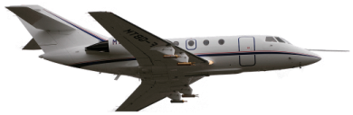
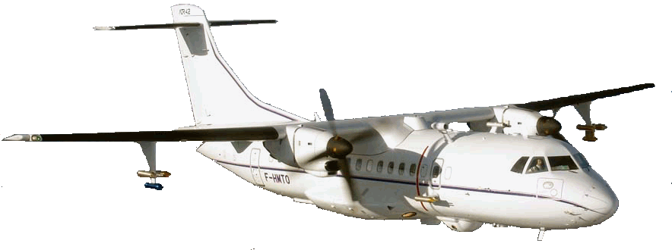
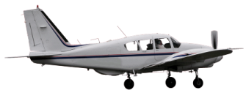
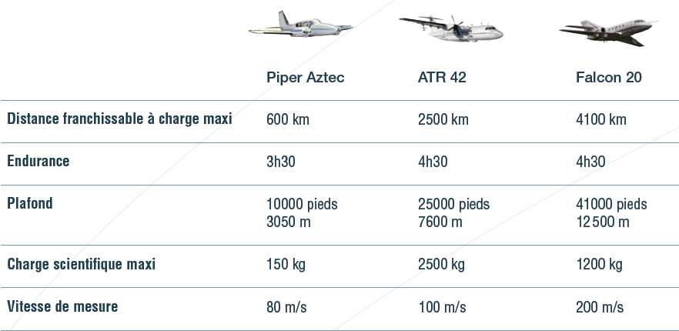
A fleet of 3 complementary aircrafts
Falcon 20:
Haute altitude
Jet for studies in the UT/LS domain
Equipped for both in situ and remote sensing mesurements
Payload 1.2T
ATR42:
Moyenne troposphère,
charge utile importante
Bi turbo-propulsor for studies in the mid troposphere. Equipped for chemistry, microphysics, turbulence by in situ and remote sensing instruments.
Payload 4.6 T
Piper-Aztec:
Basse altitude
Twin-engine for studies in urban regions and boundary layer turbulence.
Payload 200kg.
20M€ of public investment.
Notes:
2

Slide 3
Present situation:
The aging Falcon 20 can be used until 2020 but then a major and very costly overhaul would be necessary (replacement of the engines) to extend its life time.
The ATR-42 can be exploited until 2030 after an important checkup in 2020.
The Piper can still be used for 10 years
DU OA 2/2/2016

Slide 4
Pro and con of the Falcon 20
Pro
Low exploitation costs
Easily deployable and usable for transnational access
Carry both remote sensing and in situ payload
Complementary to the German fleet (plane and instruments)
Con
No aerosol vein
Limited autonomy/range
Limited power on board (Limited payload)

Slide 5
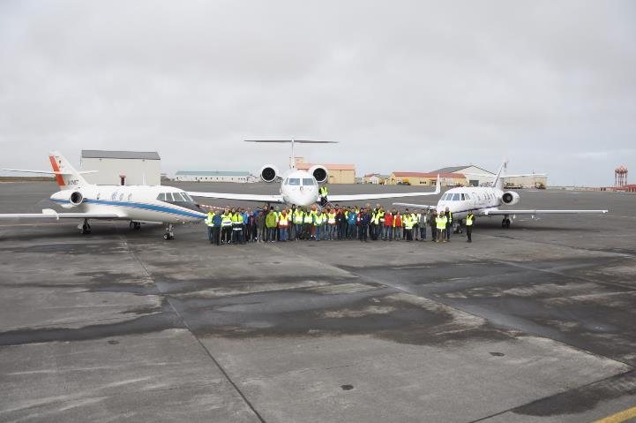
NAWDEX/EPATAN campaign – October 2016

Slide 6
Renewal of the jet
A new jet with significantly improved performances without increasing costs
Top altitude | +10% | From 13 to 14.5 km with equivalent payload
Autonomy | x2 | From 2000-3000 km to 4000-6000 km
Payload | x2,5 | From 1000 kg to 2500 kg
Electric power | x2 | From 8.5 kVA to 18 kVA
Maitenance and operation costs | -15% | Reduction by 15% of the annual contribution of funding agency to the recurrent costs of Safire – Could be converted into more flying hours for French scientists

Slide 7
Support to ESA EUMETSAT and CNES/DLR satellite missions
ADM-Aeolus (wind measurement from lidar)
Earth-Care (aerosol and cloud lidar+radar)
3MI (Multi-Viewing. Multi-Channel Multi-Polarization Imaging): Osiris (LOA)
IASI-NG + MTG-IRS (LEO and GEO new hysperspectral IR sounders)
MTG/LI (atmospheric electricity)
MERLIN (CH4 lidar): CHARM-F prototype
BIOMASS (SETHI prototype)
New projects for active instruments: MESCAL (follow on of CALIPSO), new radar (cloud and precipitation dynamics)
Objectifs (non limitatif)

Slide 8
Improve and develop new instruments
Diversity of polarisation for cloud radar
Doppler aerosol and cloud lidar
H2O lidar
Aerosol intake and AMS
PTR-MS (Proton Transfer Reactiion – Mass Spectrometry) for gases
NOx in the standard package
Electric field
SW Radiometry: OSIRIS (3MI model)
IR radiometry for the emissivity of clouds: CLIMAT
Micro-wave sounder
Objectifs (non limitatif)

Slide 9
The funding for the replacement of the jet is not yet stabilized
Replacement of the jet is the number one priority for INSU inside CNRS
The project is being carried to the 3rd « programme d’investissement d’avenir » (PIA3, investment program for the future).
20 M€ requested (8 M€ to acquire a plane on the used market, 12 M€ for transformation and certification)
The PIA3 plans to invest 5.9 billions € is research and education.

