Slide 1

EUFAR2 Stratospheric Airborne Science workshop
Rome 4-5 May 2017

Slide 8
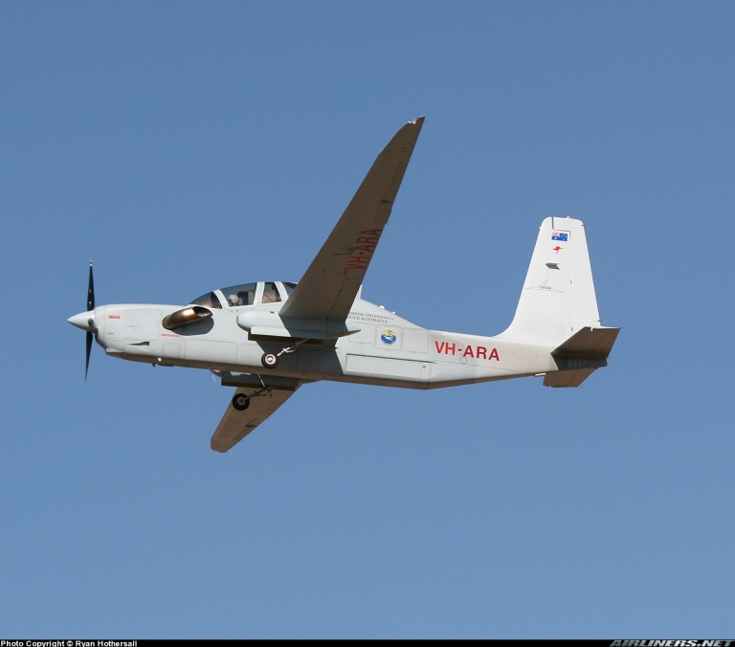
Grob G520t Egrett
Long endurance, high altitude ( 50 kFt) performance
Short runway capabilities
Reconfigurable payload installation
Full approval for all-weather IFR/Icing operations acc. to LBA/FAA Part 23 regulations

Slide 9
Current status
Two years ago, the aircraft was sold back by Airborne Research, which operated the Egrett ARA/GROB for about 10 years, to the manufacturer, Grob Aircraft AG, in Germany.
An agreement with Grob is still in force that if anybody may want to use the aircraft for science tasks, Airborne Research is available for assistance in the liaison, if necessary.
The Egrett itself is in constant operation as a demonstrator for Grob, with recent trips to SE-Asia and also South and North America.

Slide 10
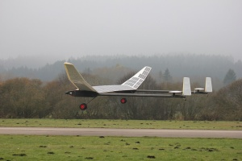
Small stratospheric aircraft for research
ELHASPA (Electric High Altitude Solar Powered Aircraft) is a demonstration and research vehicle, to advance technology and test applications for high altitude solar flight.
This platform was created in DLR in cooperation with EADS-Astrium, EADS-Cassidian, Steinbeis Flugzeug- und LeichtbauGmbH and Roedelmodell.

Slide 11
Specifications
Wingspan 23 m
Length 10 m
Empty weight 100 kg
Payload 5 kg
Engine power2 x 2 kW

Slide 12
Project status
Feasibility study completed in Dec. 2015
Project proposal under preparation
Development of a demonstrator by 2020
(cruise altitude 20 km, 5-30 kg payload)
Operational aircraft available by 2025
(flight duration: hours to days)

Slide 13

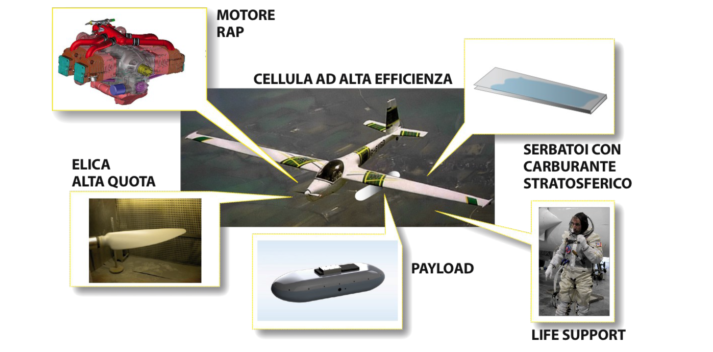
Gelsomina

Slide 14
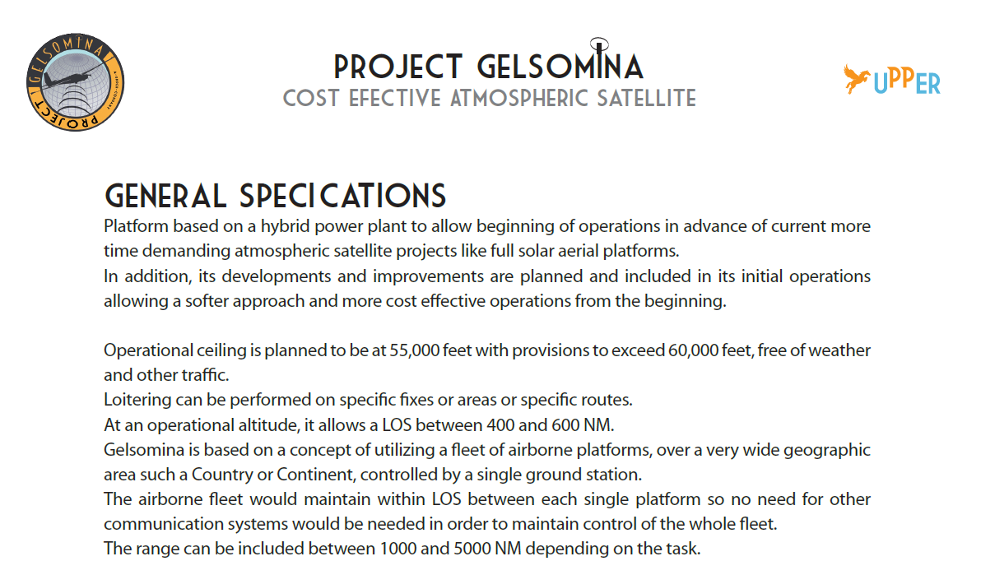

Slide 15
Project status
Feasibility study completed
Project proposal under approval
Development of a demonstrator by 2018
(cruise altitude 18 km, 100 kg payload)
Operational aircraft available by 2020
(flight duration: hours)

