Slide 1
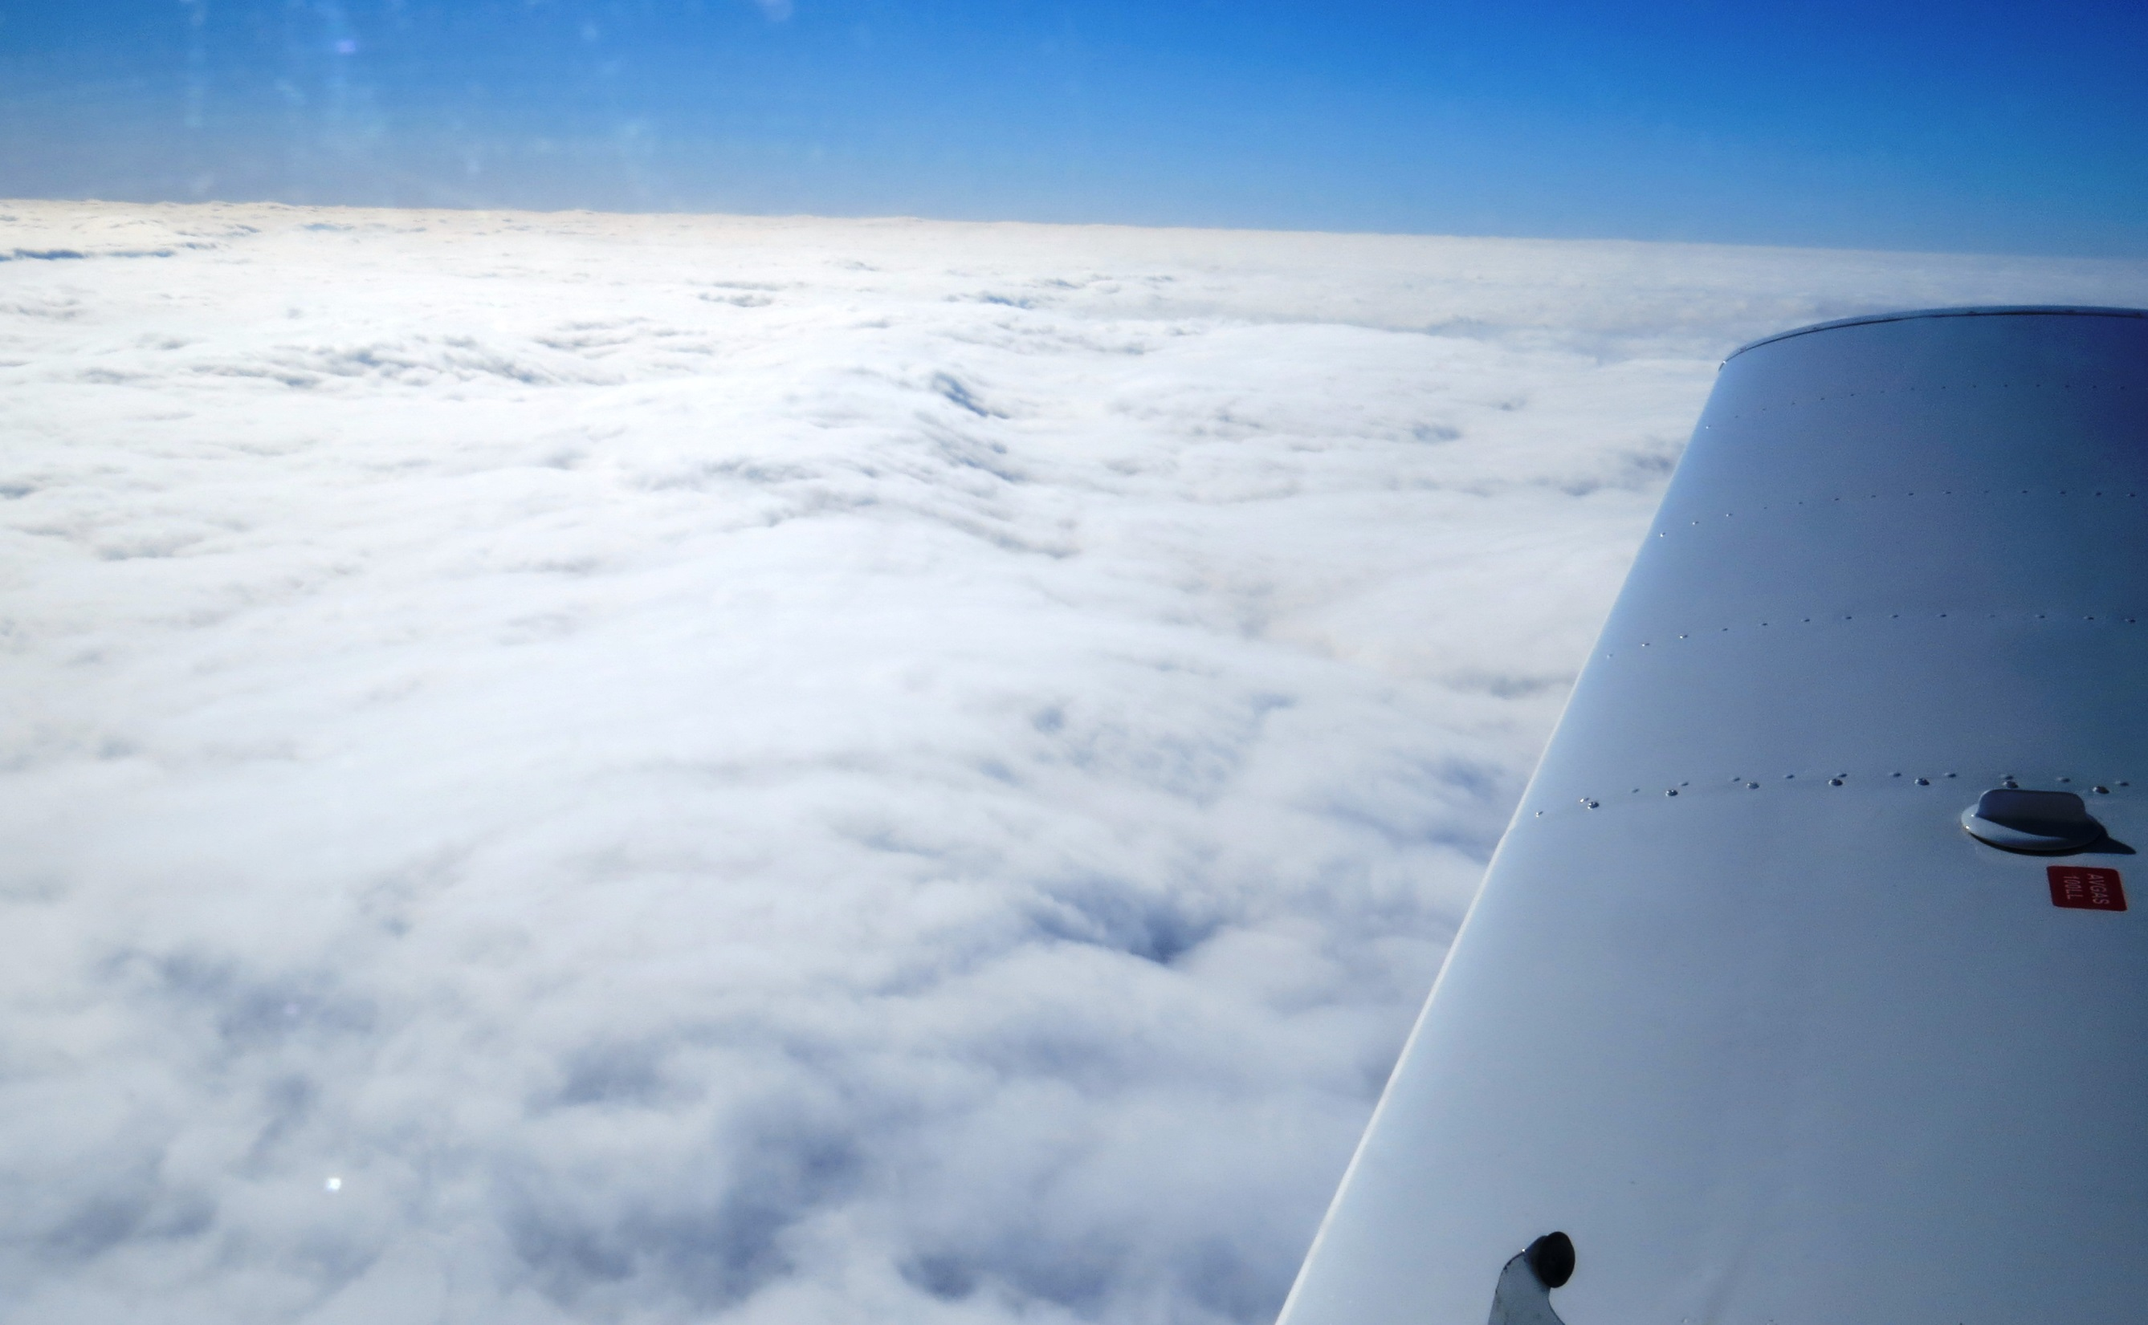


Stratospheric Airborne Science?
A (partial) British View
Prof. Guy Gratton

Slide 2
Reminder – Typical Ceilings
Unpressurised aeroplane: 12,000ft (3.7km)
Typical Turboprop (ATR42, C130): 25,000ft (7.6km)
BAe-146: 35,000ft (10.7km)
Most airliners (B737, A320…): 41,000ft (12.5km)
High performance bizjets (G550, F8X): 51,000ft (15.5km)
Military reconnaissance a/c (GH, Canberra, M55): ~60,000ft (~18.3km)

Slide 3
Above the tropopause?
Unpressurised aeroplane: 12,000ft (3.7km) NEVER
Typical Turboprop: 25,000ft (7.6km)
BAe-146: 35,000ft (10.7km)
Most airliners (B737, A320…): 41,000ft (12.5km)
High performance bizjets (G550, F8X): 51,000ft (15.5km)
Military reconnaissance a/c (GH, Canberra, M55): 60,000ft (18.3km)
(Ant)Arctic
Winter
Typical
Temperate
Equatorial

Slide 4
What defines ceiling?
Sufficient thrust to maintain level flight
  Applying to heavier than air vehicles
(2) “Coffin Corner”
  Where stall speed and Mach limits co-incide
(3) Buoyancy
  Applies to lighter than air vehicles
  Related to gas dynamics and structural elasticity

Slide 5
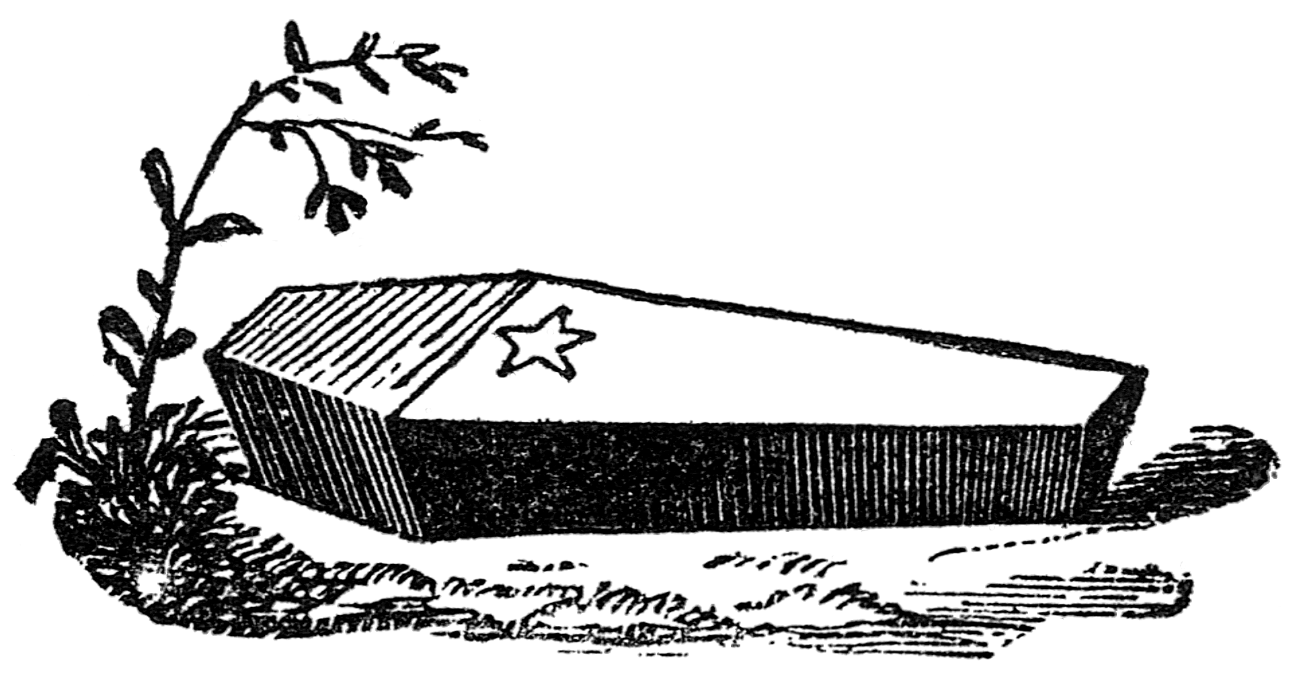
Coffin Corner
Light a/c stall ~60kts
Typical airliner ~100kts
Microlight stall ~35kts

Slide 6
UK airborne scientists survey 2016
Professor / Functional Head: 24
Other science related role:7
Senior Lecturer / Reader / Senior Research Fellow: 13
Postdoctoral researcher or research engineer: 10
Lecturer / Research Fellow: 6
Ground based research facilities manager: 1
Early career researcher: 5
Project support science / engineering role: 1
Postgraduate student: 3
=69 total

Slide 7
Disciplines
Atmospheric physics / atmospheric dynamics: 47
Meteorology: 29
Atmospheric chemistry: 29
Climatology: 11
Remote sensing: 3
Geology / Volcanology: 2
Aerosol science:2
Radiation science: 1
Astrophysics: 1

Slide 8
Perceived problems with the BAe-146
Limited endurance: 23
Low service ceiling: 19 (28%)
Limited aircraft range: 18
Ability to fly low level over the UK: 4
Difficulty in reaching distant and remote locations: 4
Limited ability to fly in convective clouds: 3
Ability to fly at lower speeds (~<80m/s?): 3

Slide 9
Critical characteristics of BAe-146
Ability to conduct low flying: 39 (56%)
Ability to carry large and varied payloads: 23 (33%)
Service ceiling (should not be less): 21 (30%)
Range (should not be less than at present): 14 (20%)
Endurance (should not be less than at present): 14 (20%)
Cloud microphysics capability (should be at-least as good as at present): 12 (17%)

Slide 10
Aspirations to improve future science
Enhanced remote sensing instrumentation: 11 (16%)
Greater aircraft range: 10 (15%)
Cloud radar: 8 (12%)
Greater endurance: 7 (11%)
Higher service ceiling: 7 (11%)
Aerosol instrumentation and/or inlets: 4
Bioparticle and holographic spectrometers: 4

Slide 11
Working conclusion
We have limited stratospheric ability
~25% of atmospheric scientists want to improve it

Slide 12
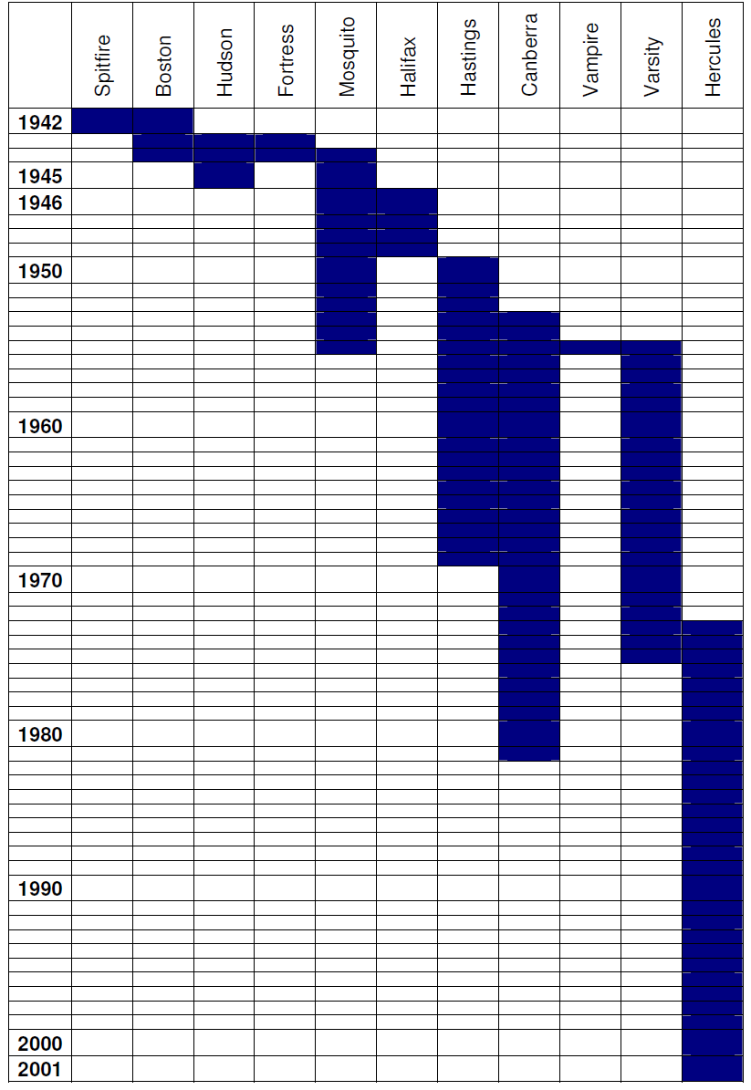
UK History

Slide 13
Potential aircraft #1
UK is considering a BAe-146 replacement
Timescale ~2025
May be a high performance bizjet
  Falcon 7X?
  51,000ft / 15.5km
  No decision yet made

Slide 14
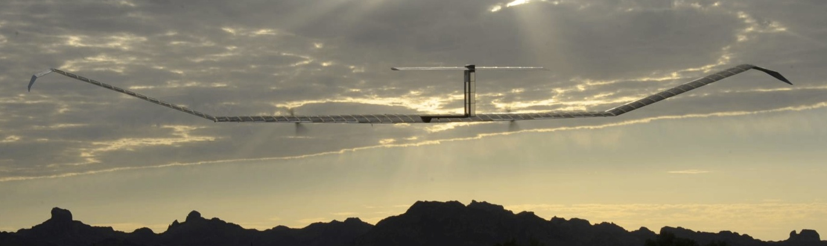
Potential aircraft #2
Qinetiq / Airbus Zephyr (7 or 8?)
2 week+ endurance, 60,000ft+
Small (1.5kg/ 40W → 5kg/200W) Payload

Slide 15
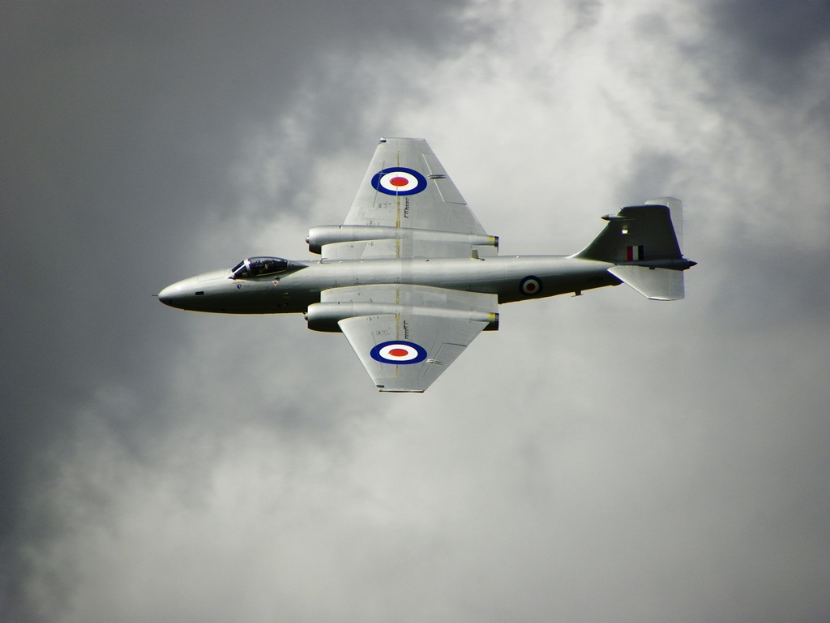
Potential Aircraft #3
Canberra PR9 XH134
Has been airworthy in last 2 years
~1.5 tonnes payload
55,000+ft ceiling
  (17km)
Available now
https://www.bonhams.com/auctions/23589/lot/99/

Slide 16
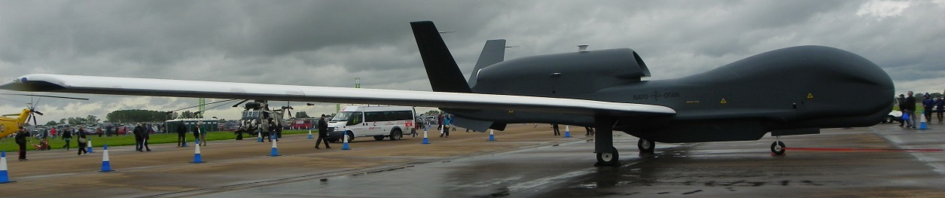
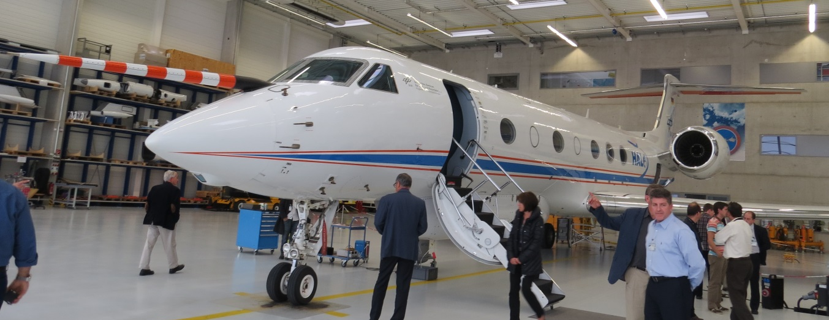
Foreign aircraft use?
NASA Global Hawk – some history
DLR HALO – no history yet – only 15km
ER2?, WB57?, White Knight?

Slide 17
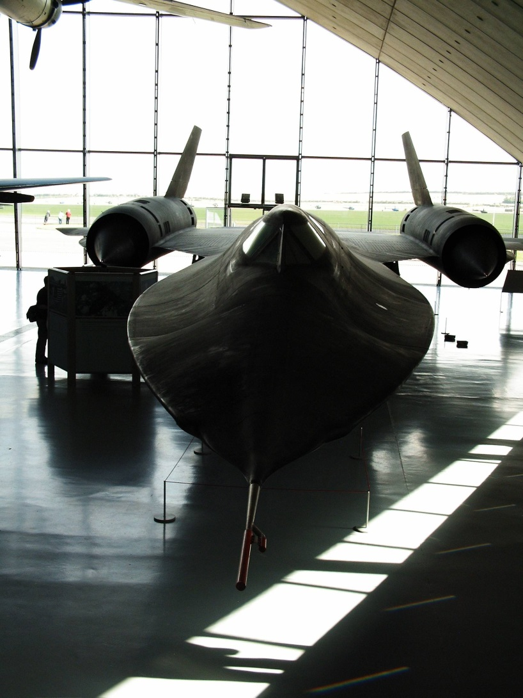
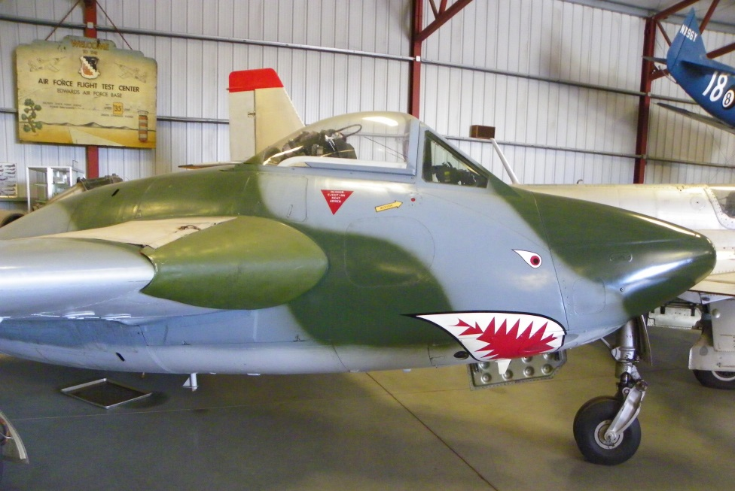
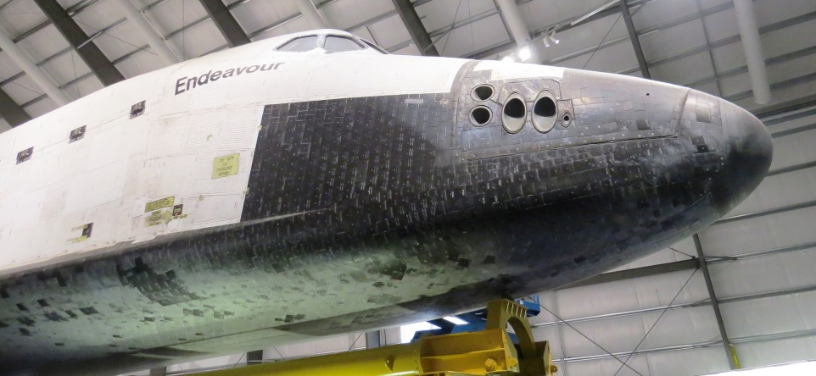
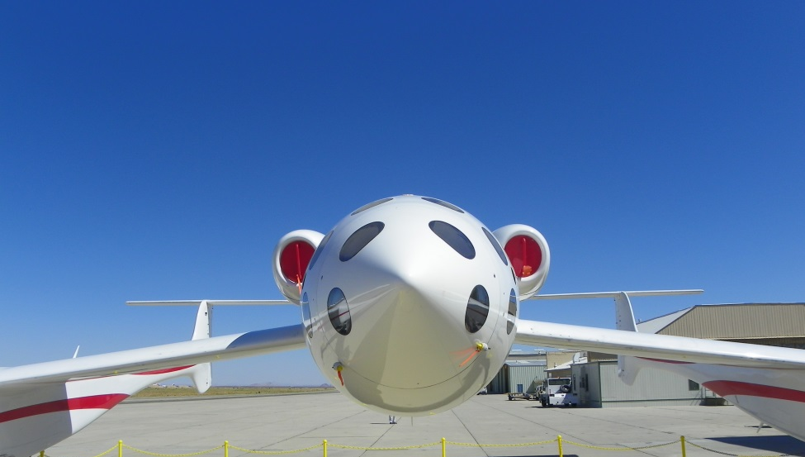
Discussion?
guat@faam.ac.uk

