Slide 1
Airborne measurements applied to the testing and evaluation of clouds in atmospheric models
Steven Abel
steven.abel@metoffice.co.uk
Introduction
- The role of research aircraft for model evaluation and development of clouds
- What observations do the models need?
Example of the use of aircraft data to improve model rainfall prediction
Use multiple aircraft datasets to develop improvements to a model parameterization
Illustrate use of a case-study approach to test this new model parameterization
Summary
Pass over to Paul Field who will talk about aircraft sampling biases in convective clouds

Slide 2
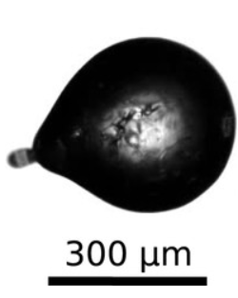
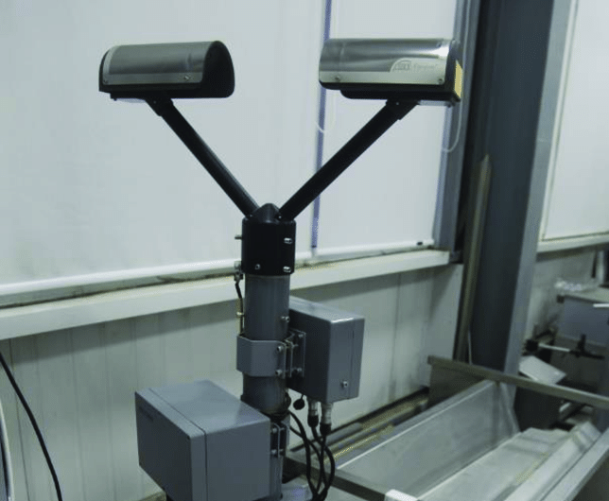
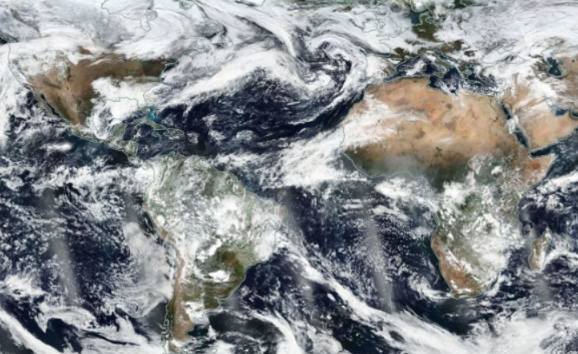
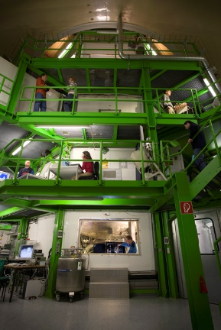

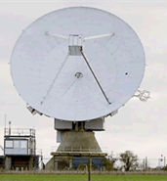
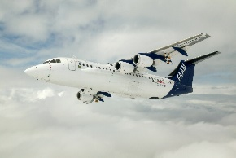
Observations of clouds for model evaluation and development
Laboratory studies
Controlled environmental conditions
Repeatable experiments
Ground sites
Good temporal coverage but often at fixed locations
Observations at surface or remote sensing
Dependant on local cloud conditions
Satellites
Long term measurements
Global coverage
Passive and active sensors (cloud top property retrievals, profiling radar)
O(km) resolution
Aircraft
In-situ data of bulk cloud properties and microphysics
In-situ measurements of thermodynamic environment in which clouds form
Target cloud regimes of interest (within aircraft limits)
High frequency data to examine small spatial scales
Poor temporal coverage
Keinert et al. (2020)
Disdrometer
VIIRS, NASA Worldview
3V-CPI imagery
FAAM aircraft
AIDA cloud chamber
Chilbolton radar

Slide 3


Microphysics: What do models need from in-situ aircraft data?
100 km → 100 m
Most weather and climate models use bulk cloud microphysical parameterization schemes to predict 1 or 2 moments of the particle size distribution of different hydrometeor species (cloud, rain, ice, snow, graupel) within a model grid-box
Schemes need information on microphysical parameters (grey box) to calculate transfer rates of mass (and number) between hydrometeor species
Research aircraft observations are a unique tool for providing detailed in-situ observations of key microphysical parameters used for both model evaluation studies and for guiding the development of the microphysical parameterization schemes
$$\overline{T}, \overline{P}, \overline{q_{v}}$$
Ice Mixed-phase Liquid Cloud free
(Ice Snow Graupel)
Particle size distribution (PSD)
Phase (ice/liquid/mixed-phase)
Particle mass/density
Particle fall-velocity
Bulk mass (LWC/IWC)
Cloud fraction in the grid-box

Slide 4
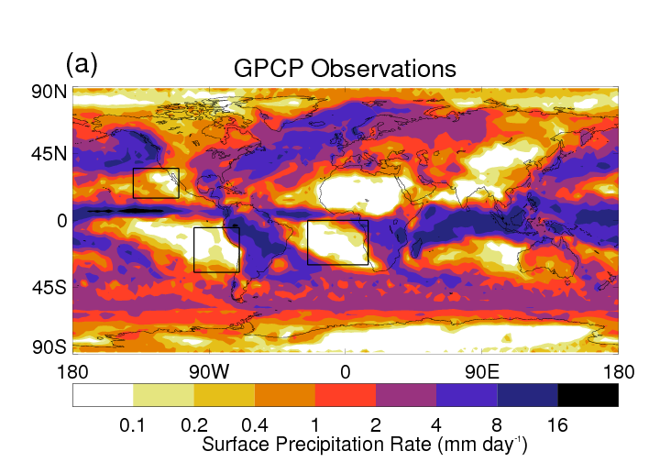
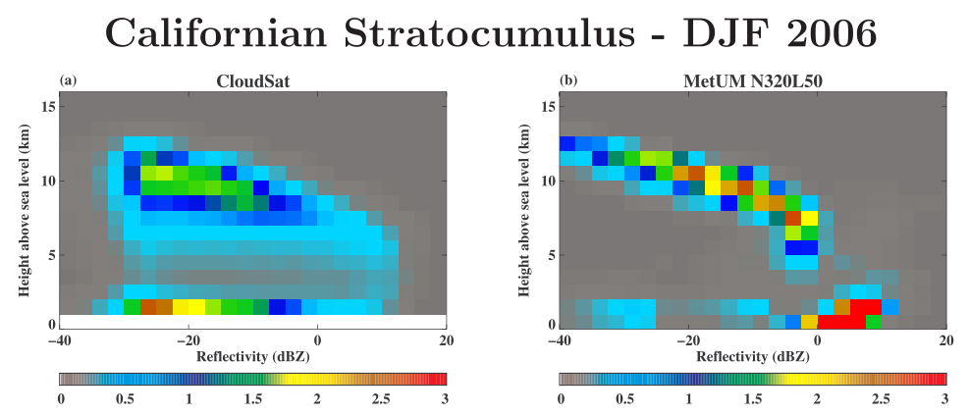
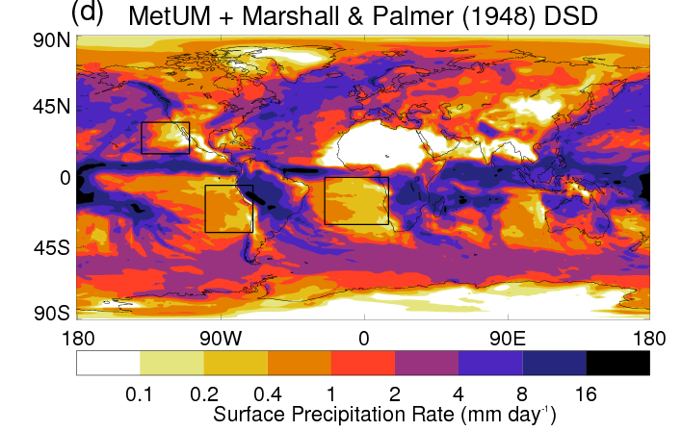
Example: A warm rain bias
Forecasters - “Excessive areal coverage of precipitation, especially light rain/drizzle in warm sectors... This is a frequently seen, long standing problem”
Californian Stratocumulus
Observed
Radar reflectivity α D⁶
Model
Cloud Rain
Model overestimates surface rainfall in Sc regions
High radar reflectivity (rain) mode when compared to spaceborne radar observations

Slide 5
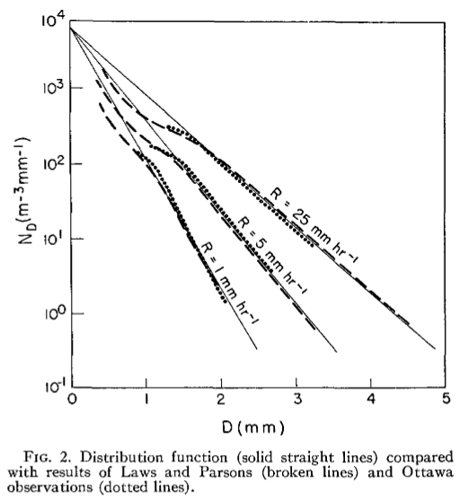
The model raindrop Particle Size Distribution (PSD)
Based on surface based observations made in Ottawa, Canada in the 1940s (Marshall & Palmer, 1948). Caught raindrops on a few hundred dyed filter papers. Drops left stains on the dye, the diameter of which was related to raindrop size.
Except for at small sizes drop sizes, the PSD could be fitted with an exponential distribution of the form
For 1M schemes such as the Met Office model, λ can be calculated from the model predicted rain mass, q_{R}
Observations were not representative of small drizzle sized drops
The Marshall-Palmer PSD was still being used in the operational Met Office regional configurations of the NWP model in 2013!
$$N\left(D\right)=N_{0}\exp\left(−λD\right) ;N_{0}=8.0e^{6} m^{−3} m^{−1}$$

Slide 6

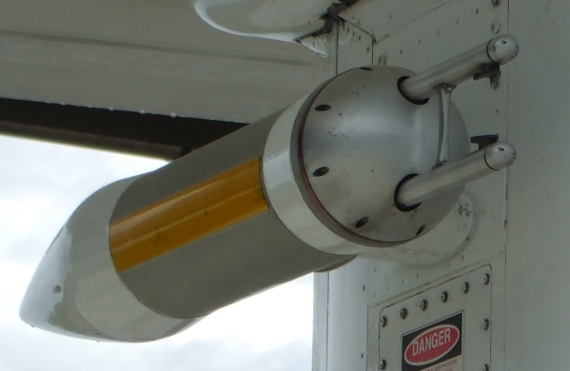
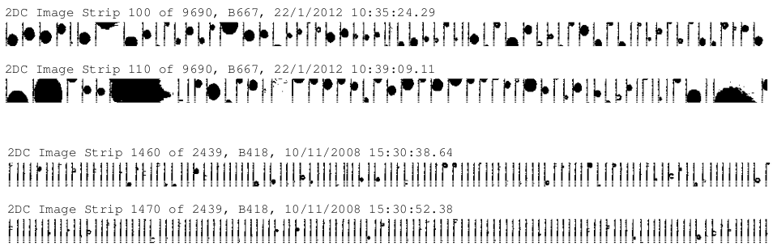
How do we measure the size of raindrops on an aircraft?
Concentration
Raindrops in cumulus
Size
800 µm
Drizzle drops in stratocumulus
800 µm
Temporal frequency

Slide 7
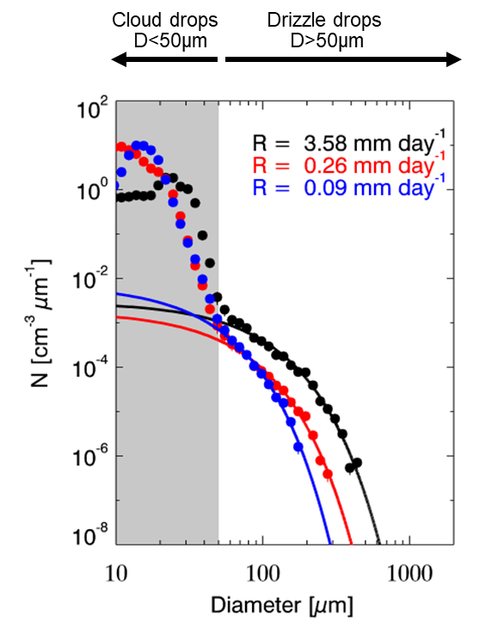

Example PSD from aircraft measurements
Drizzle from stratocumulus clouds in the SE Pacific (FAAM aircraft, VOCALS-Rex campaign)
Exponential size spectra fitted to particles with D > 50 µm to determine N₀ and λ
$$N\left(D\right)=N_{0}\exp\left(−λD\right)$$

Slide 8
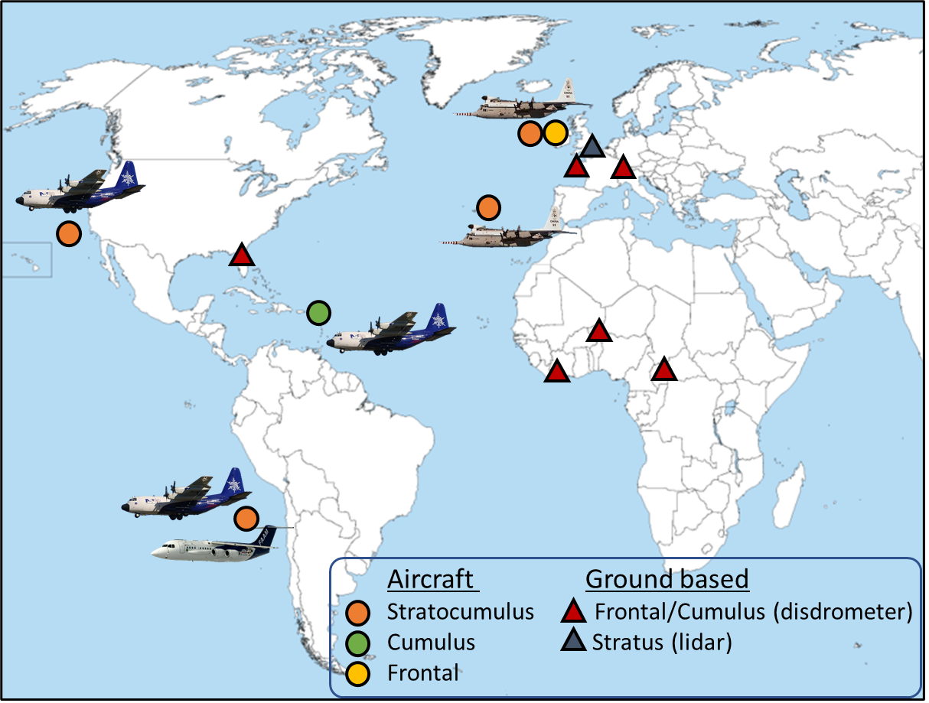
Measurements of the raindrop PSD
Build up a large dataset of raindrop PSD in warm rain to test Marshall-Palmer relation and to develop a new parameterization
Parameterizations need to be valid in all relevant cloud regimes
Aircraft observations in Sc and trade-wind Cu (warm-rain only).
Melted snow/ice from frontal/convective clouds (mostly surface observations using disdrometers but also aircraft data)
Surface lidar retrievals from stratus/Sc

Slide 9
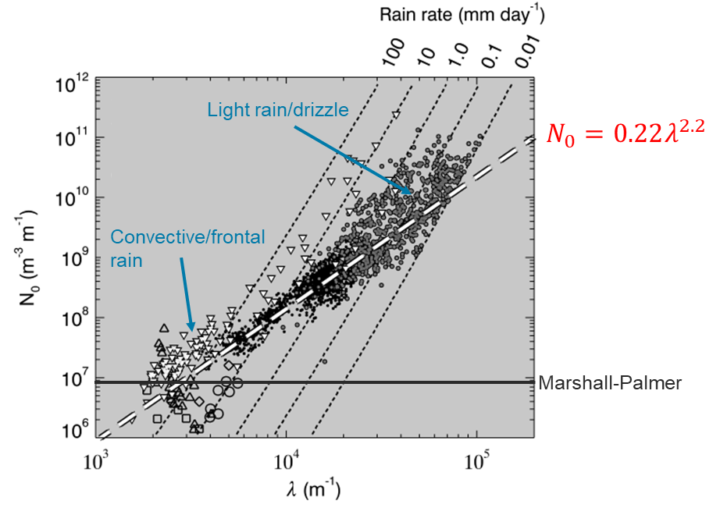
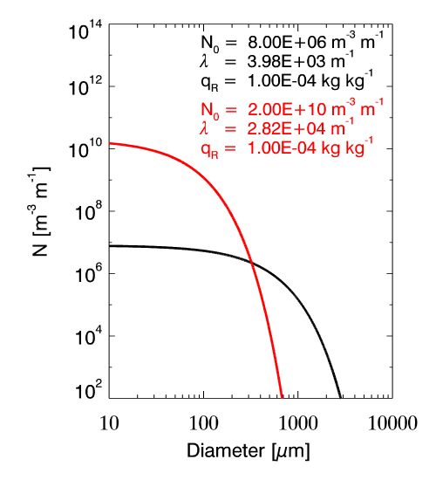
Observations show that the PSD contains higher concentrations of small drops at low rain rates (rain mass)
Light rain conditions
New relation
Marshall-Palmer

Slide 10
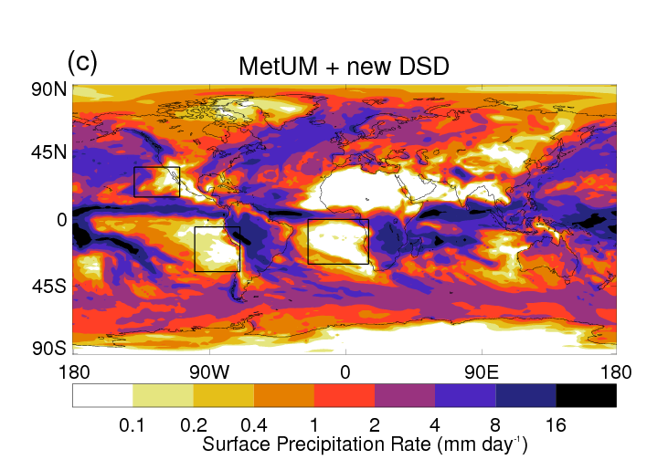
Impact in the model
New raindrop PSD reduces surface rainfall bias in stratocumulus regions

Slide 11
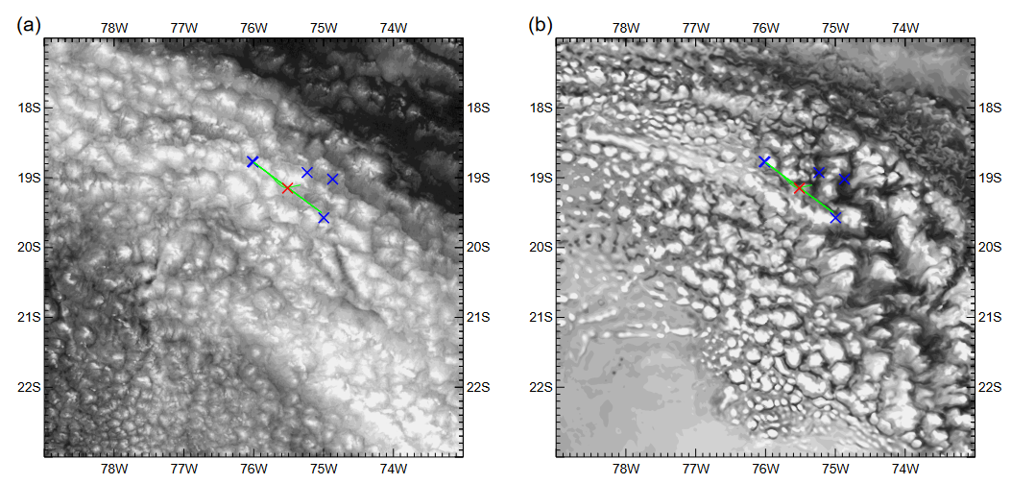
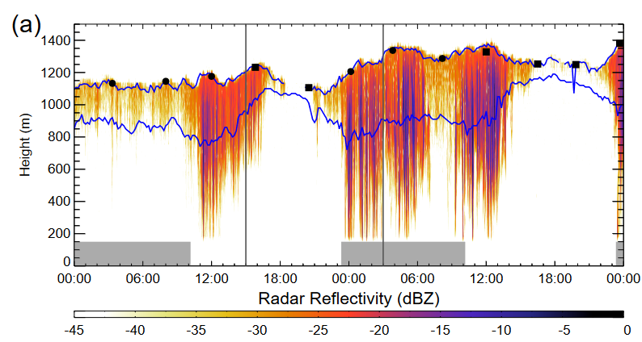
Case-study of stratocumulus in the SE Pacific
Drizzling stratocumulus
Aircraft runs in the cloud and sub-cloud layer co-ordinated with the ship
X Ship (radar)
--- Aircraft track
Satellite
1km model
Vertically pointing radar on ship

Slide 12
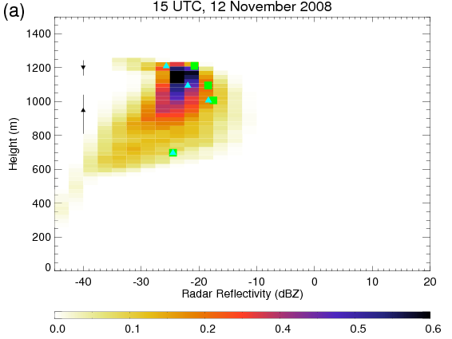
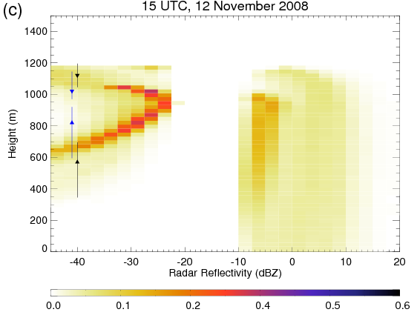
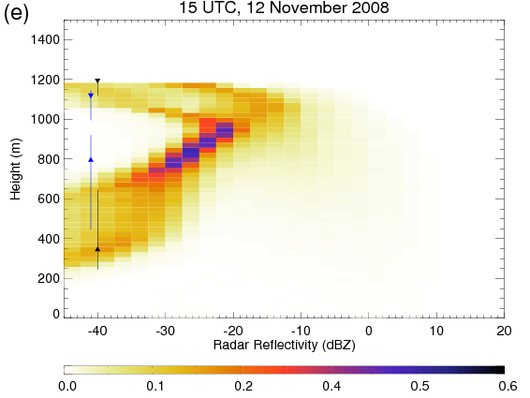
Impact in the model: case-study of drizzling stratocumulus
Observations Marshall-Palmer PSD New raindrop PSD
Cloud base
Aircraft
Shipborne radar measurements show drizzle evaporates as it falls below cloud base
Aircraft measurements from an overflight of the ship are overlaid
New raindrop PSD removes large rain drops (high dBZ) and allows precipitation to evaporate below cloud base.
Used in operational NWP and climate models at the Met Office since 2013

Slide 13
Summary and thoughts
Airborne measurements are a key and unique tool for providing in-situ cloud microphysical data to evaluate and develop atmospheric models.
Case-study approach from field campaigns in certain cloud regimes/locations can be really useful for improving our understanding of key cloud processes and for detailed model sensitivity studies.
Utilising datasets from all relevant cloud regimes/multiple field campaigns has benefits for parameterization development. Important to have good archiving and easily available campaign datasets that are well documented to do this.
EUFAR data archive https://www.eufar.net/data-archives/
Aircraft measurements can provide cloud measurements on small spatial scales, which will become increasingly important for challenging the next generation of forecast models with grid resolutions of approaching 100m.
Flight strategies and how do fairly compare aircraft data to model simulations?

