Slide 1
How biased is convective cloud sampling?
Paul Field
Kalli Furtado

Slide 2
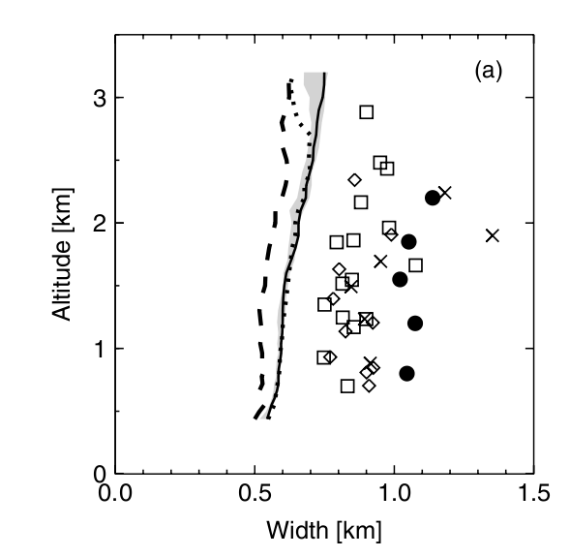
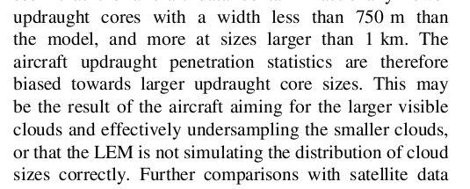
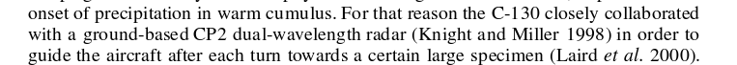
Abel and Shipway 2007 QJ : RICO clouds
Neggers et al. 2006 QJ : SCMS

Slide 3
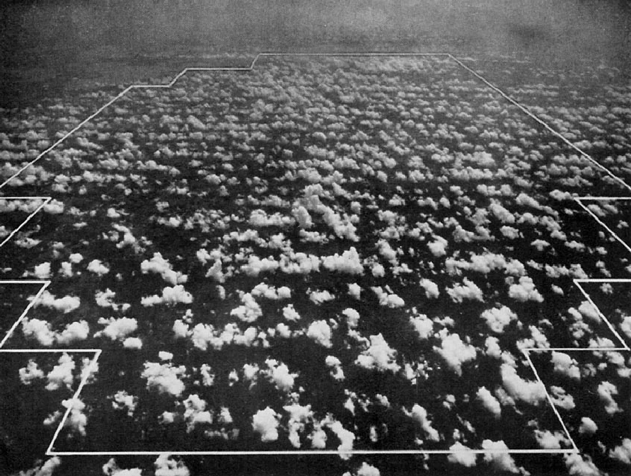

Slide 4
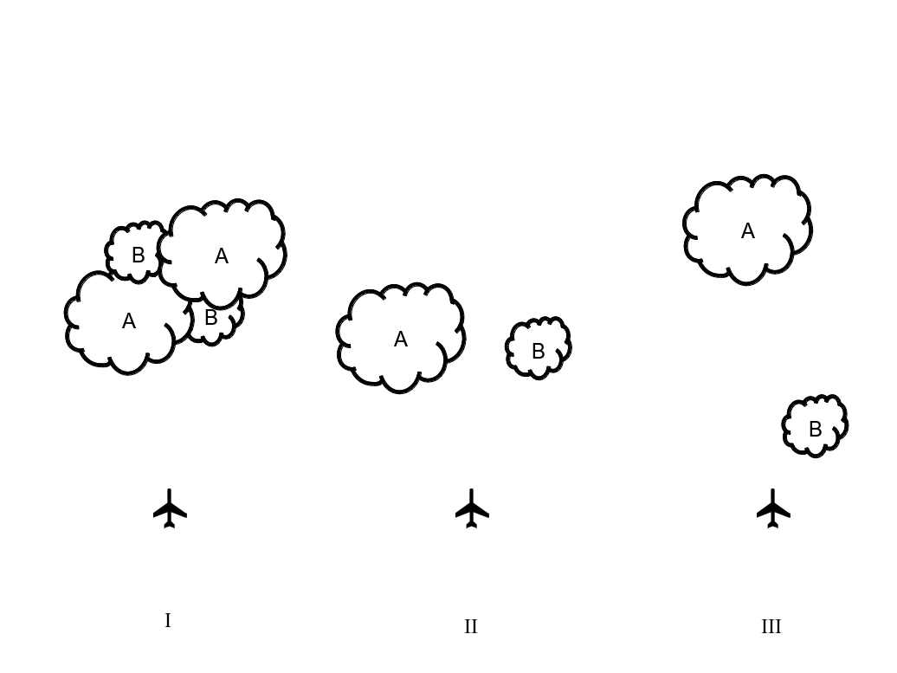

Slide 5

1
0
3/4

Slide 6
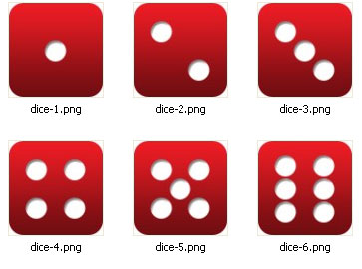
Choose largest
1
2
3
4
5
6
1
2
3
4
5
6

Slide 7
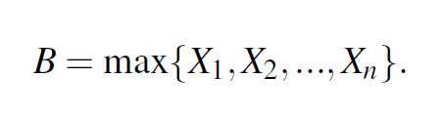
B is a random variable equal to the maximum of the independent identically distributed random variables X1, X2, Xn
Picking heads from 2 coins
½ x ½
½ x ½
½ x ½
P_{B2}(y) = P(X1=y)P(X2<y) + P(X2=y)P(X1<y) + P(X1=y)P(X2=y)
Probability of choosing a value y as the largest of the two random variables (X1,X2)
probability that X1 is y AND X2 is smaller than y
probability that X2 is y AND X1 is smaller than y.
probability that X1 is y AND X2 is y
=
+
+
Picking
1/6 x 5/6
1/6 x 5/6
1/6 x 1/6
=11/36
Picking
1/6 x 0
1/6 x 0
1/6 x 1/6
=1/36

Slide 8
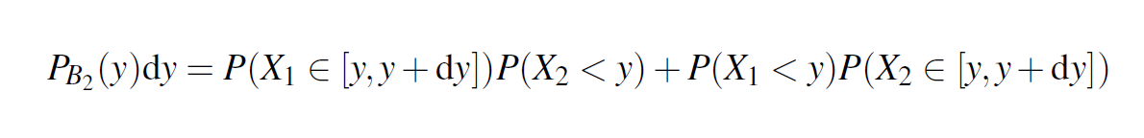
B is a random variable equal to the maximum of the independent identically distributed random variables X1, X2, Xn
Probability of choosing a value between y and y+dy as the largest of the two random variables (X1,X2)
probability that X1 lies between y to y+dy AND X2 is smaller than y
probability that X2 is lies between y to y+dy and X1 is smaller than y.
=
+

Slide 9
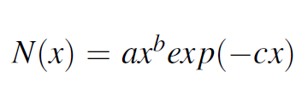
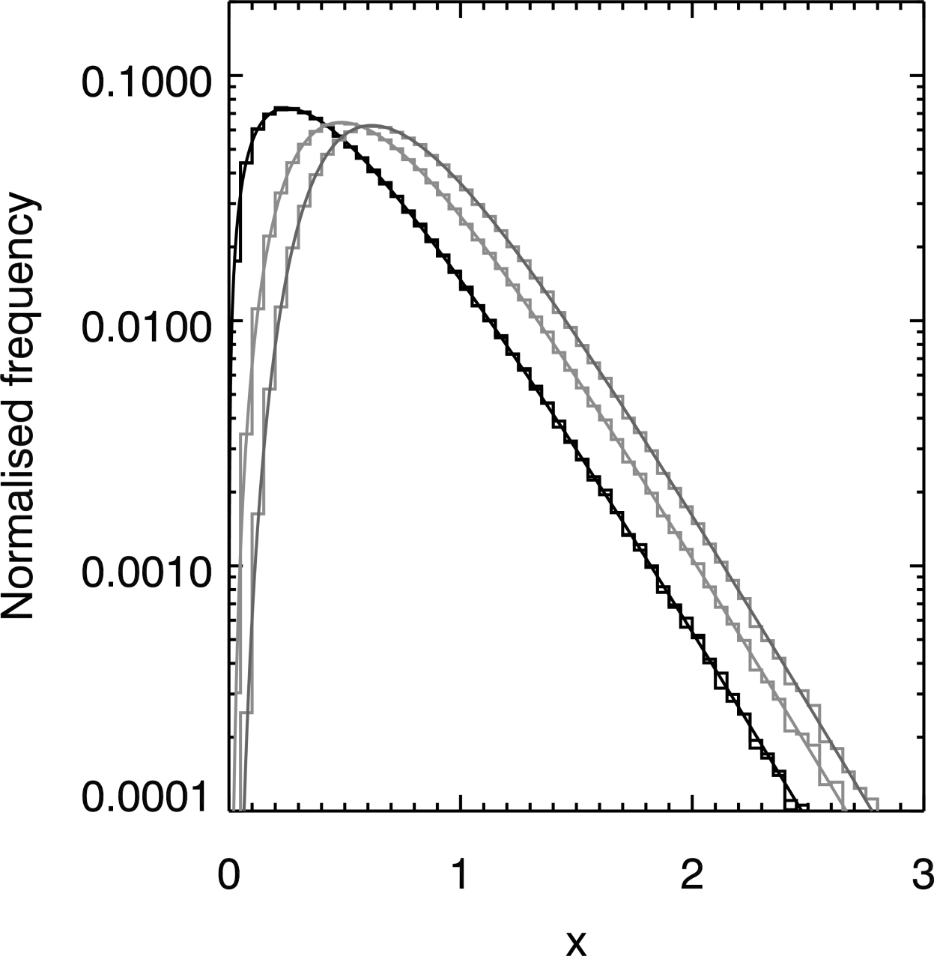
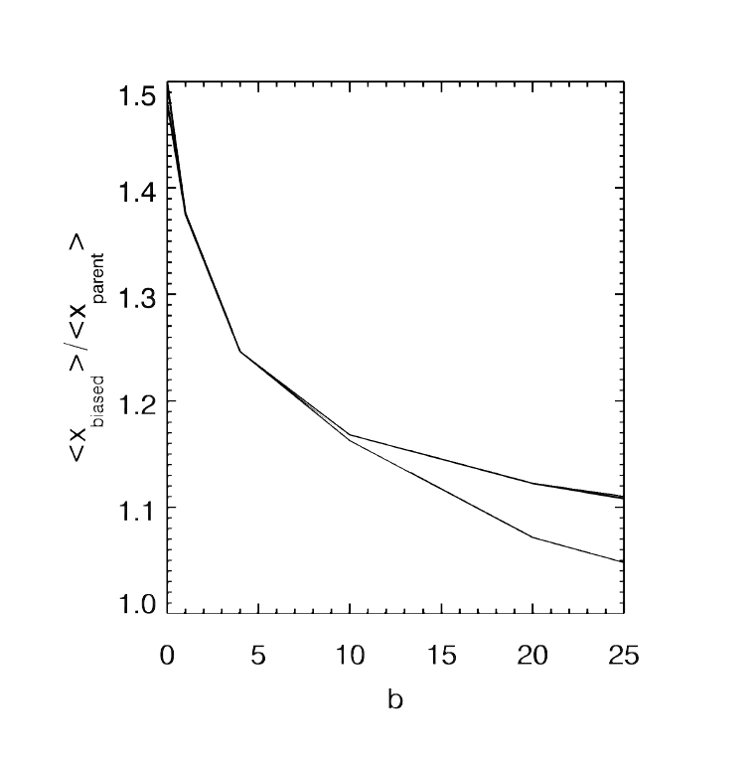
Choose largest from 2
Choose largest from 3

Slide 10
Choose largest from 2
Choose largest from 3

Slide 11
Summary
If the underlying distribution of the parent distribution used to select clouds follows a gamma distribution then an additional error bar could be included with the observations. This would indicate the potential bias in the mean value due to using a choose the larger rule.
The methods presented in this study can be used to estimate the effect for other distributions.
when planning sampling strategies for convective clouds ensure that random choices are made between clouds. For instance this could be achieved by flying between fixed ground points.
https://doi.org/10.1175/JTECH-D-15-0148.1

